Slide 1
Testing with Selenium

Slide 2
Selenium IDE

Slide 3
What is Selenium IDE?
Selenium IDE is a plugin for Firefox that allows you to record your actions and replay them.
It is mainly used for short actions that are repeatable and were the data stays the same.
Intended to be a rapid Prototyping tool, for advanced tests,
they should be exported into a project and finished using WebDriver

Slide 4
Installing Selenium IDE
Install Firefox version 50.1.0 as later versions do not work correctly with the IDE
Make sure you disable automatic updates
Once installed go to http://docs.seleniumhq.org/download/
Or search download Selenium
Find the IDE section and click the Firefox download link

Slide 5
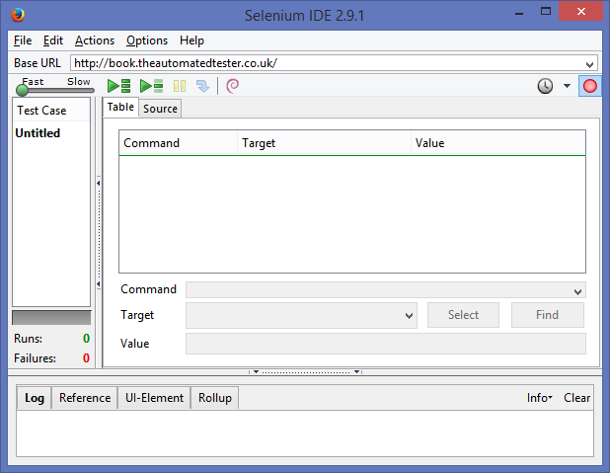
Using Selenium IDE
Recording Status
Play Test(s)
Test List
Test Commands

Slide 6
Once you have set the IDE to record simply run the test manually on the site.
The IDE will now record your actions
Why is what you’ve done so far not a test?
To make what you have done so far a test you need to add in some verifies and asserts
To do this simply right click on the element you want to check and show all available commands
And Select the option you want

Slide 7
Common Commands
Command | Explanation
Type | Sets the value of an input field, as though you typed it in.
Open | Opens a page using a URL
clickAndWait | Clicks on a link, button, checkbox or radioButton, if that click action triggers a lod event, it will then call waitForPageToLoad
Select | Selects an option from a drop-down using an option locator
selectFrame | Selects a frame within the current window
Verify/AssertTitle | Verifies that the title of the page matches the value given
verifyTextPresent | Verifies that the specified text pattern appears somewhere in the rendered page
verifyElementPresent | Verifies that the specified element is somewhere on the page
waitForPageToLoad | Waits for the page to load, this is called after any command postfixed with andWait
waitForElementPresent | Waits a specified/default amount of time for an element to appear on the page
waitForTextPresent | Waits a specified/default amount of time for expected text to appear on the page.
waitForTextNotPresent | Waits a specified/default amount of time for expected text to disappear from the page.

Slide 8
The Difference between Verify and assert
Assert and Verify commands exist for the same areas, such as assertTitle and verifyTitle
If an assert fails, the test stops.
If a verify fails, the test continues but logs the failure.
waitFor is similar to assert in that it will fail if it doesn’t become true within the timeout period.
Loading pages Example
Assert that the page has loaded
Verify that a button has appeared
Click the button
Assert that the next page has loaded
Verify that certain elements have appeared

Slide 9
Exercise
Create a test that:
Additional
Goes to http://www.seleniumhq.org
Click on the chat room link
Checks that the Support button is there
Check the page has loaded
Clicks the button
Fill out the form
Check the page has been loaded
Check the page has loaded
Check that “Getting help” header is there
Check the #selenium chat tab is there

Slide 10
Selenium Webdriver

Slide 11
Adding Webdriver
Selenium requires a vast quantity of .jar files to add to your Java Project to work
Project Properties -> Build Path -> Add External Jar -> Add all of the provided jars
For each web browser that you want to test you need to do two things.
Download the appropriate driver
Set the system path to that drivers location
Before you instantiate the driver in your code all the following line
(Chrome example)
System.setProperty("webdriver.chrome.driver","C:\\filepath\\chromedriver.exe");
(FireFox example)
System.setProperty("webdriver.gecko.driver", "C:\\filepath\\geckodriver.exe");
3. You can also store the driver in the root of your project and it will automatically find it without the need to set the property.

Slide 12
Creating a test with webdriver
A Selenium test usually is made up of three methods:
1. A before method
2. A test method
3. An after method
Notes:
Ask what they think the three things are. Ask what they think each part does.

Slide 13
@Before method
Usually called setup() as It is meant to be for creating your webdriver
This is also a good place to put anything else you wish to create that is only used for each test
i.e. setting up a report or logger to track the test
You can have multiple @Before methods but it is bad practice to have them, so only ever make one of these methods

Slide 14
@Test method
This method is where your test code goes.
If your test is more complex then a few actions then it may be best to move it into a different class and call it from this method
The final line of this method is usually your assert
There is no limit on how many test methods you can have

Slide 15
@After method
Usually called tearDown() as you are cleaning up after your code has finished
This is where you would quit your webdriver to stop processes staying around after your test has finished. i.e. stopping your computer crashing after running tests several times.
You can have multiple @After methods but it is bad practice to have them, so only ever make one of these methods

Slide 16
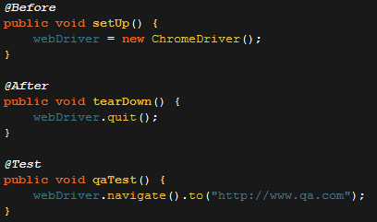
Basic Example

Slide 17
Finding Elements
Now you know how to set up a selenium test it is time to look at how you get elements from the page to interact with
To find elements with Selenium we use things called selectors
There are multiple types of Selectors that all have their pros and cons to using them

Slide 18
Selectors
Method Call | Description
By.name(String) | Find elements based on their name
By.id(String) | Find elements based on their ID
By.className(String) | Fid elements based on the value of the class attribute
By.linkText(String | Find elements based on their linktext
By.XPath(String) | Find elements using xpath
By.CSSSelector(String) | Find elements via their css
By.partialLinkText(String) | Find elements that contain the given link text
By.tagName | Find elements via their tag name.

Slide 19
Usually the best Selectors to use would be:
ID
CSS/Xpath
Class name
Name
Link Text
Tag name
Partial Link text

Slide 20
CSS and Xpath selectors

Slide 21
CSS Selectors
CSS stands for Cascading style sheets.
They are used to give style to html documents and webpages.
They work by finding certain criteria and applying their style to it.
We can use them to do the same thing except for applying style we can find the element we want to manipulate.

Slide 22
XPath selectors
XPath is used to navigate through elements and attributes in an XML document.
Stands for XML Path Language.
Utilises ‘path like’ syntax to identify and navigate through nodes in an XML document.

Slide 23
Using css
Symbol | Meaning
. | Represents that following String is a class
# | Represents the following String is an ID
> | Represents that the next command is the next child
div | Selects all the divs that are children of the current element
Span | Selects all the Spans that are children of the current element
div:nth-child(n) | Selects every div element that is the nth child of its parent
div:nth-of-type(n) | Selects every div element that is the nth div element of its parent
For more selectors go to :- https://www.w3schools.com/cssref/css_selectors.asp

Slide 24
Using Xpath
Symbol | Meaning
nodename | Selects all nodes with the name "nodename"
/ | Selects from the root node
// | Selects nodes in the document from the current node that match the selection no matter where they are
. | Selects the current node
//title[@lang='en'] | Selects all the title elements that have a "lang" attribute with a value of "en"
/bookstore/book[price>35.00] | Selects all the book elements of the bookstore element that have a price element with a value greater than 35.00
* | Matches any element node
For more selectors look at :- https://www.w3schools.com/xml/xpath_syntax.asp

Slide 25
Using Webdriver

Slide 26
Common Commands
Command | Outcome
Webdriver.navigate.to() | It will tell Selenium to go to a specific url. The url must contain http:// or https://
Webdriver.findElementBy() | It will tell Selenium to find an element from the dom with a certain selector
Webdriver.findElementsBy() | It will tell Selenium to find all the elements from the dom with a certain selector
.click() | This will tell Selenium to click the element
.sendKeys() | This will tell Selenium to input the string into an element
isDisplayed() | This will ask Selenium if the element is current visible/displayed on the screen
.getAttribute() | This will ask Selenium to retrun the attribute of an element

Slide 27
Webelements
What is a WebElement?
A Webelement is an object from the dom that has been found by the webdriver
The actions that you can make on a webpage are usually to an individual thing
A Webelement represents any one of those things. So actions are made to a Webelement

Slide 28
Setting up Webdriver
DEMO

